Slide 1

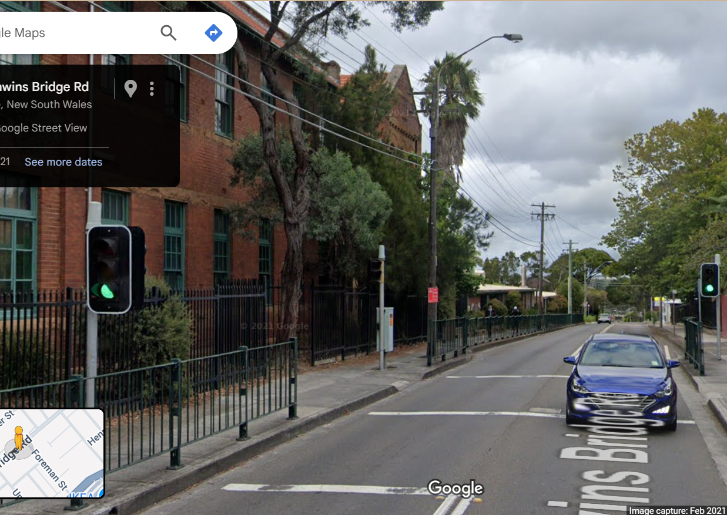
Pi Pico OOP Mini Project
Ben Jones
Tempe High School
Lecture 5
Notes:
Welcome to lecture 5
So far, we have created a fully functioning LED_light Class
and pedestrian_button Class
Along with unit tests for both Classes

Slide 2

Simple Open Loop Control System
Traffic Lights remain green until pressed (idle state).
Button pressed triggers state change.
Lights rotate through a pattern based on time.
System returns to idle state
Notes:
This lecture will focus on the auditory notification
This notification makes crossing more accessible to
users who are blind or vision-impaired acting
as a user interface so that the user knows when
they can cross the street.

Slide 3
Today
Implement an audio notification Class including a beep
Write documentation for our Class
Unit test the audio notification
Notes:
Today we will implement an audio notification Class
uses a series of beeps
Write developer documentation for the Class
Then, write a unit test for the audio notification Class

Slide 4

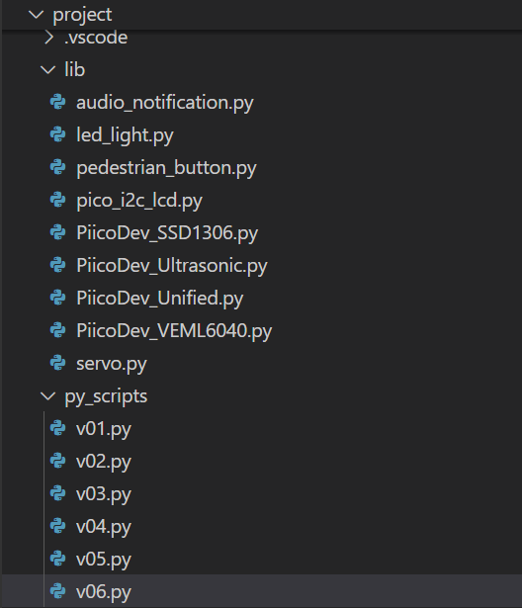
Create new files
v06.py in project\py_scripts\
audio_notification.py in project\lib\
Notes:
Start by creating a v06 .py in py scripts where you will
implement your unit test
Then create an audio notification .py in the lib folder
Where you will develop your Class as an abstraction
from your main line

Slide 5
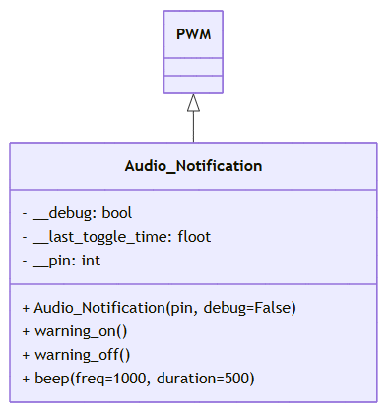
UML
Notes:
This is the UML of our audio notification Class
It inherits the PWM Class and calls the inherited methods
But does not implement any polymorphism
We have attributes for debugging, time and the pin
We have a method to create a single beep and
to turn the warning on/off

Slide 6
Audio_Notification Imports
from machine import Pin, PWM
from time import sleep, time
Notes:
These are our imports
PWM is our Super Class, different from the LED or button
Again will we use time as an associated Class
I want to point out I am not modelling time the UML
To make the UML diagrams clearer to understand.

Slide 7
Audio_Notification Class Initialiser & Attributes
Class Audio_Notification(PWM):
def __init__(self, pin, debug=False):
super().__init__(Pin(pin))
self.__pin = pin
self.__debug = debug
self.__duty_u16(0) # Start with buzzer off
self.__last_toggle_time = time()
Notes:
The Class initialiser calls the super initialiser of the Super Class
Then stores the attributes as encapsulated variables

Slide 8
Audio_Notification .beep() Method
def beep(self, freq=1000, duration=500):
if self.__debug:
print("Beep")
self.freq(freq)
self.__duty_u16(32768) # 50% duty cycle
sleep(duration / 1000)
self.__duty_u16(0) # Turn off after beep
Notes:
We first need to make a single beep method that can be called
At intervals to make a warning signal
Once you have created this method, you can instantiate a
Object then call the object.beep() to test the beep.
The use of sleep makes this method is blocking but
as the block is brief it is an acceptable payoff for the
simple implementation is an a

Slide 9
Audio_Notification .warning_on() Method
def warning_on(self):
if self.__debug:
print("Warning on")
now = time()
if now - self.__last_toggle_time >= 0.5:
self.beep(freq=500, duration=100)
self.__last_toggle_time = now
Notes:
This is a non blocking method that calls the beep
Every 0.5 seconds to create an audio notification

Slide 10
Audio_Notification .warning_off() Method
def warning_off(self):
if self.__debug:
print("Warning off")
self.__duty_u16(0) # Turn off sound
Notes:
This method sets the PWM duty cycle to zero
Which means there is no current in the PWM signal
Turning the audio notification off

Slide 11
Add documentation to your Class
Class LedPico:
"""
Simple Class to turn an LED on or off on a Raspberry Pi Pico.
Args:
pin (int): GPIO pin number for the LED.
Example:
led = LedPico(25) # Onboard LED
led.set(True) # Turn on
led.set(False) # Turn off
"""
def __init__(self, pin):
from machine import Pin
self.led = Pin(pin, Pin.OUT)
def set(self, state: bool):
"""
Set the LED on or off.
Args:
state (bool): True to turn on, False to turn off.
"""
self.led.value(1 if state else 0)
Class-level docstring: Briefly describes what the Class represents and lists its attributes and methods.
Constructor docstring: Explains what parameters are needed to create an instance.
Method docstrings: Describe what each method does and what parameters it takes.
Notes:
Using this example as a template write developer documentation
For your audio notification Class
Documentation should describe the purpose/why
not the implementation/how
“Set the LED on or off” is good documentation
As it describes what the method does
Compared to
“Set pin high or low” is poor documentation
As it just says how it does it and does give any context

Slide 12
Unit Test the Audio_Notification Class
Your unit test should test all methods, where possible, because it involves an auditory sound you should design a manual test.
Pause the video, design your unit test, then check your unit tests against my suggested batch of unit tests.
Notes:
Lastly your task is to design and implement a unit test
in v06.py for your audio notification Class.
Because it is an auditory output, it does require
manual intervention to validate the test.
Press pause and when finished look at
My solution to see how you went.

Slide 13
